Slide 1

Predict 200 daily most streamed songs on Spotify's Worldwide Daily Song Ranking
INFO6105 Final Project
Fangyu Cui
Fang-Wen Tseng
Yuwei Zhang
Jiawen Yin

Slide 2
Problem
Given a large data set, predict streams for Spotify’s songs by building a Random Forests model and a Neural Networks model
Spotify’s Worldwide Daily Most Listened Songs

Slide 3





Dataset
Content: The original dataset contains the daily ranking of the 200 most listened songs in 53 countries from 2017 and 2018 by Spotify users.
Link: https://www.kaggle.com/edumucelli/spotifys-worldwide-daily-song-ranking
Original Big Data Set:
Shape: (3441197, 7)
Feature: position, track name, artists, streams, URL, date, region
After data cleaning and processing: (you can see how we implement it in the later slides)
Shape: (1152043, 20)
Feature: position, name, artist, streams, date, region, danceability, energy, key, loudness, mode, speechiness, acousticness, instrumentalness, liveness, valence, tempo, duration_ms, time_signature

Slide 4

Solution
Iris Dorn and Arin G trained model predictions regarding streams and position, respective to time. And their study explored songs features and their correlation to ranking and streams, also attempted to ARIMA modeling. Feature like, Artist, track name, danceability, duration, energy, instrumentals, key, liveness, loudness, mode and etc.
Sweetmusicality using proportion - by using the percent the song was streamed relative to all other songs. And the result showed the top streamed song on Spotify by country, and correlation between the top stream songs and artists.
Some Existing Solution From Other Study

Slide 5
Implementation

Slide 6
Steps
Read Data In
Data Cleaning and Processing
Drop URL column
Concatenate 2017 & 2018 data
Split datetime and convert object datetype data to numerical numbers
Create reference table for name, artist, and region
Deal with NaNs (Missing values)
Standardize continuous columns
Split Data into Train-Valid-Test Data Sets
Build Random Forests Models and Neural Networks Models
Evaluate Models on Test Data Sets

Slide 7
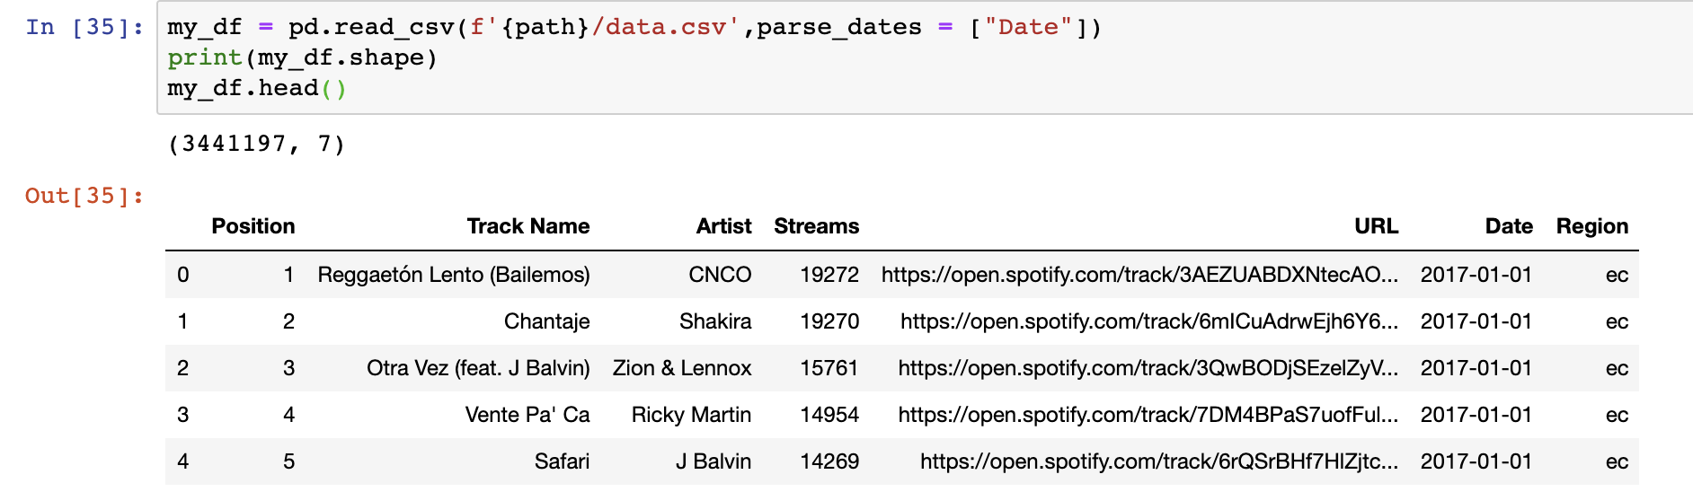
Read Data In
This big data set has 344194 columns and 7 rows, which is a very giant data set. Therefore, we will do some data cleaning and processing in the next step

Slide 8
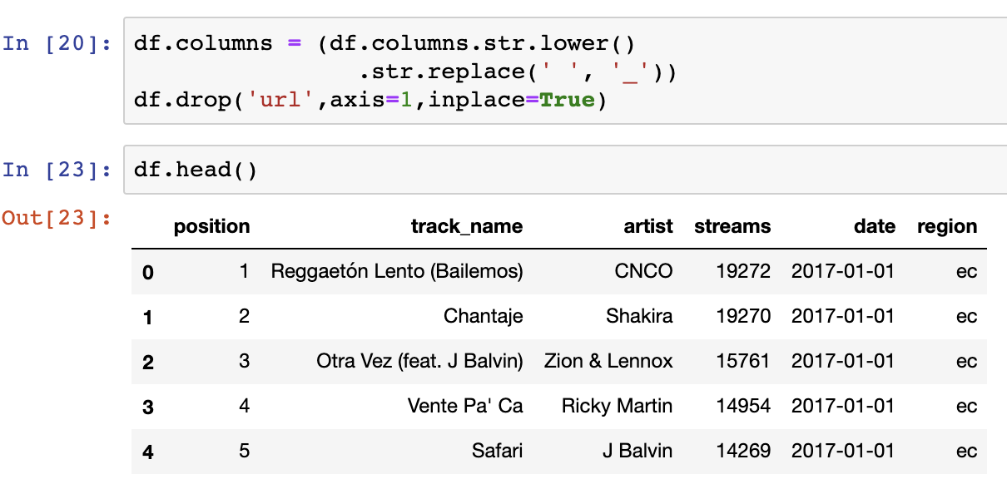
II. Data Cleaning and Processing
Drop URL Column
This is a very giant data set, since URL has nothing to do with streams, we will drop the URL column from our big data set. We will then create the features columns from this URL columns

Slide 9
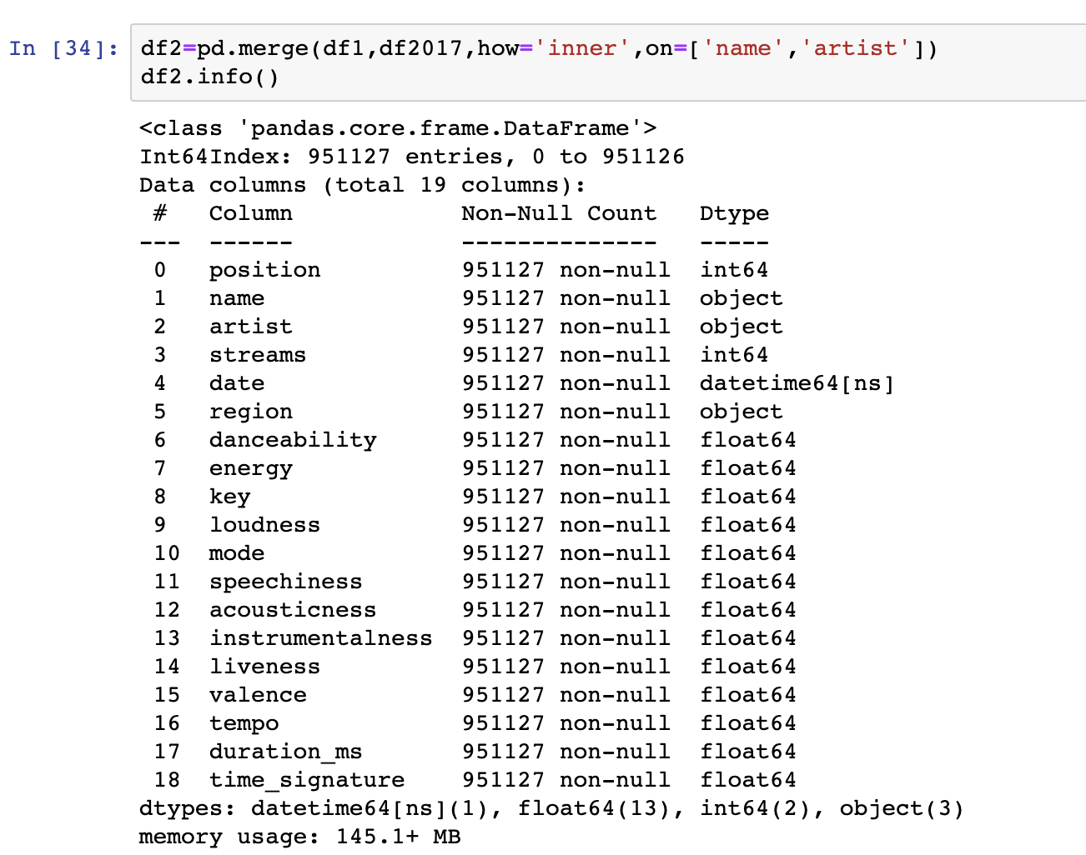
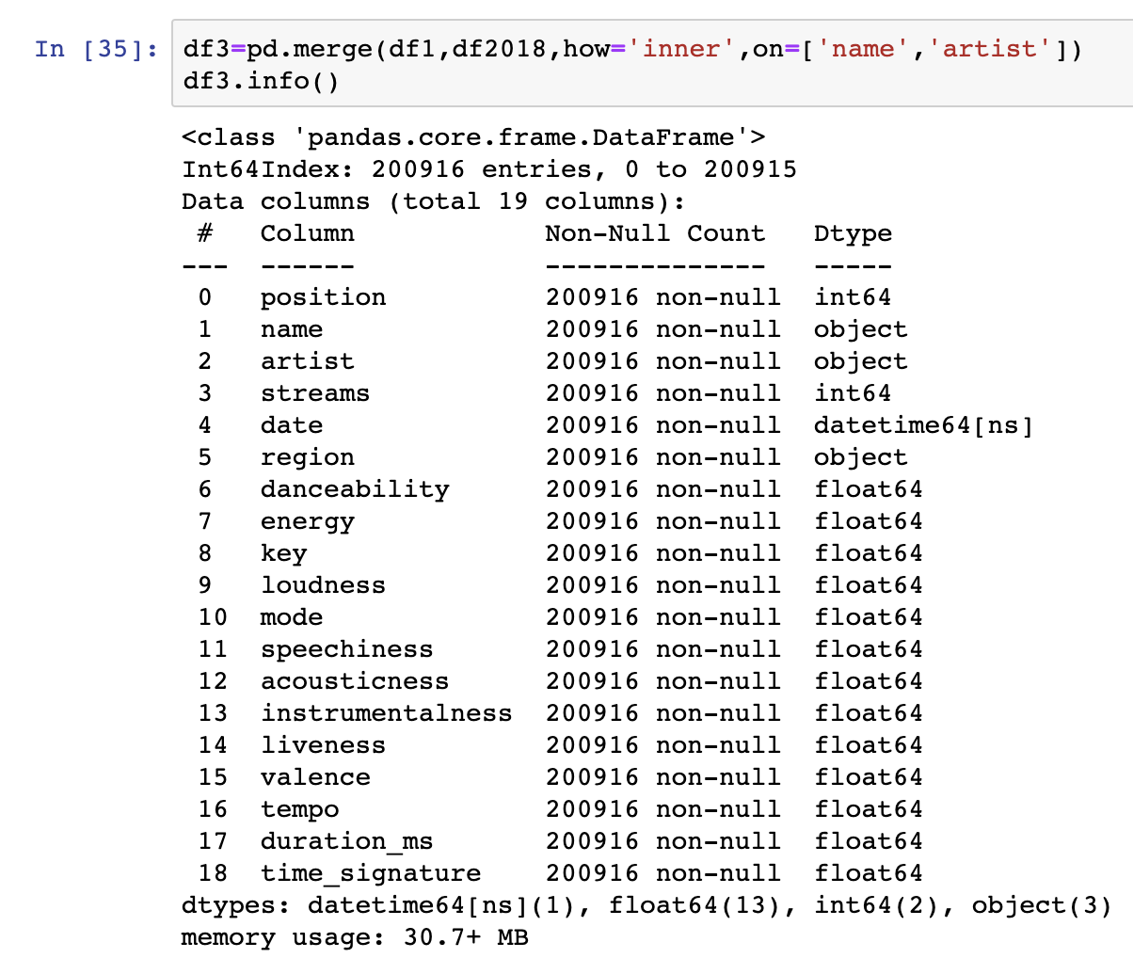
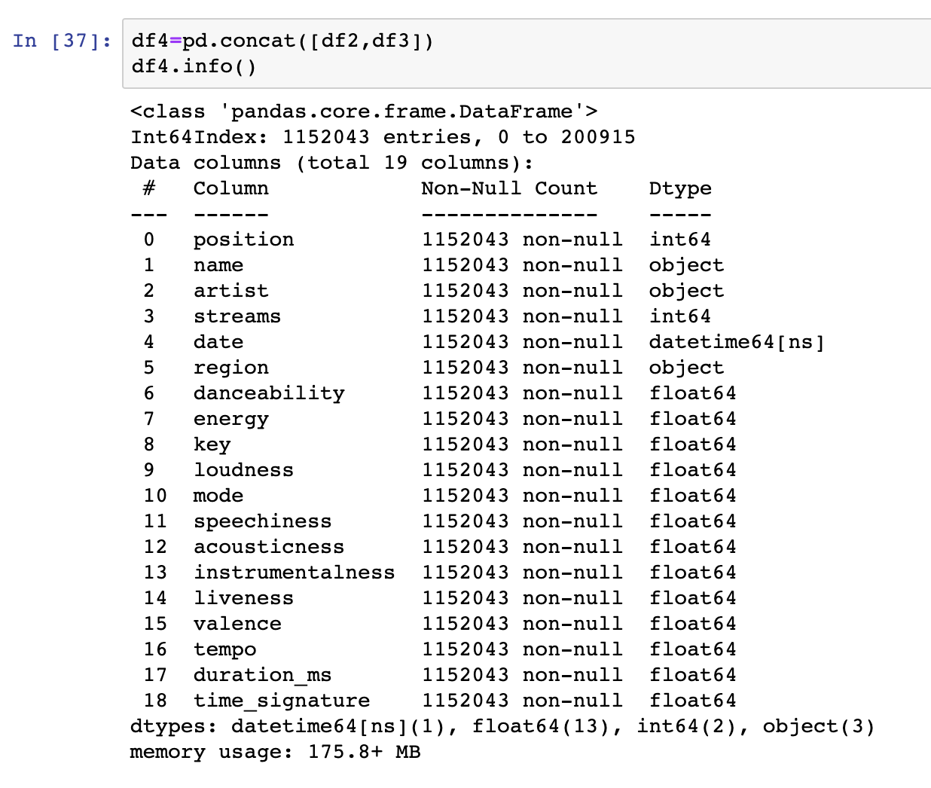
B. Concatenate 2017 & 2018 data
We are merging 2017 & 2018 data into the big data set

Slide 10
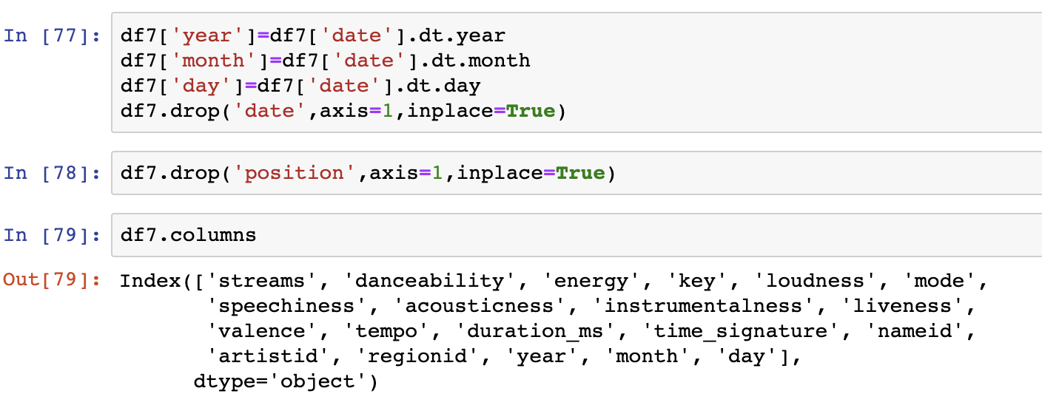
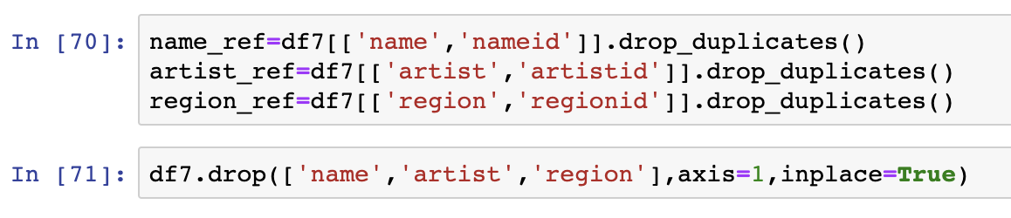
C. Split datetime and convert object datetype data to numerical numbers
D. Create reference table for name, artist, and region

Slide 11
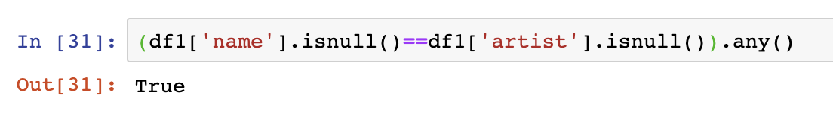
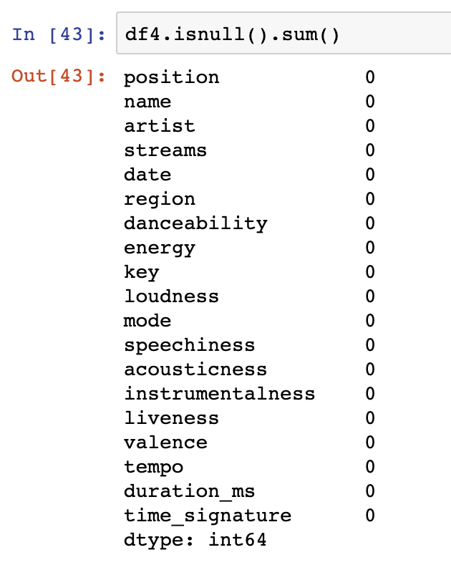
E. Deal with NaNs (Missing values)
Checking if rows of records missing names also missing artist name

Slide 12
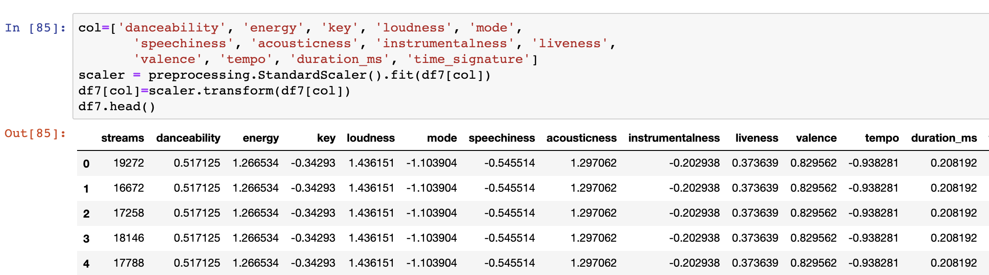
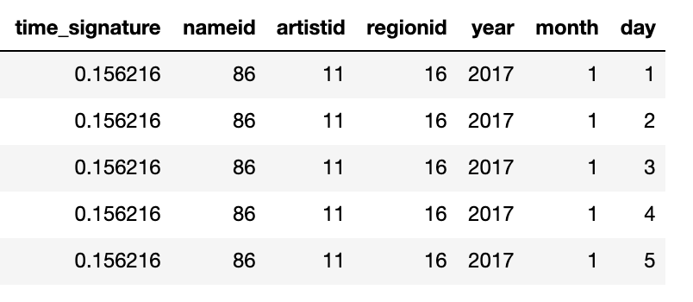
E. Standardize continuous columns
We got these features columns from the URL columns in the original big data set and then we standardized these features

Slide 13
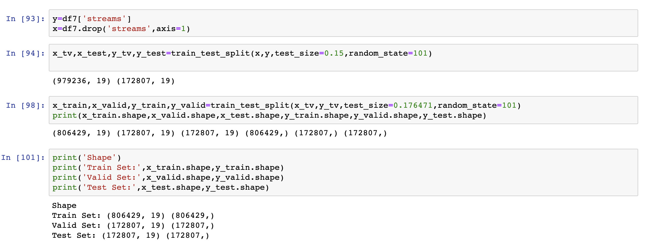
III. Split Data into Train-Valid-Test Data Sets
Train 70%, Valid 15%, Test 15%

Slide 14
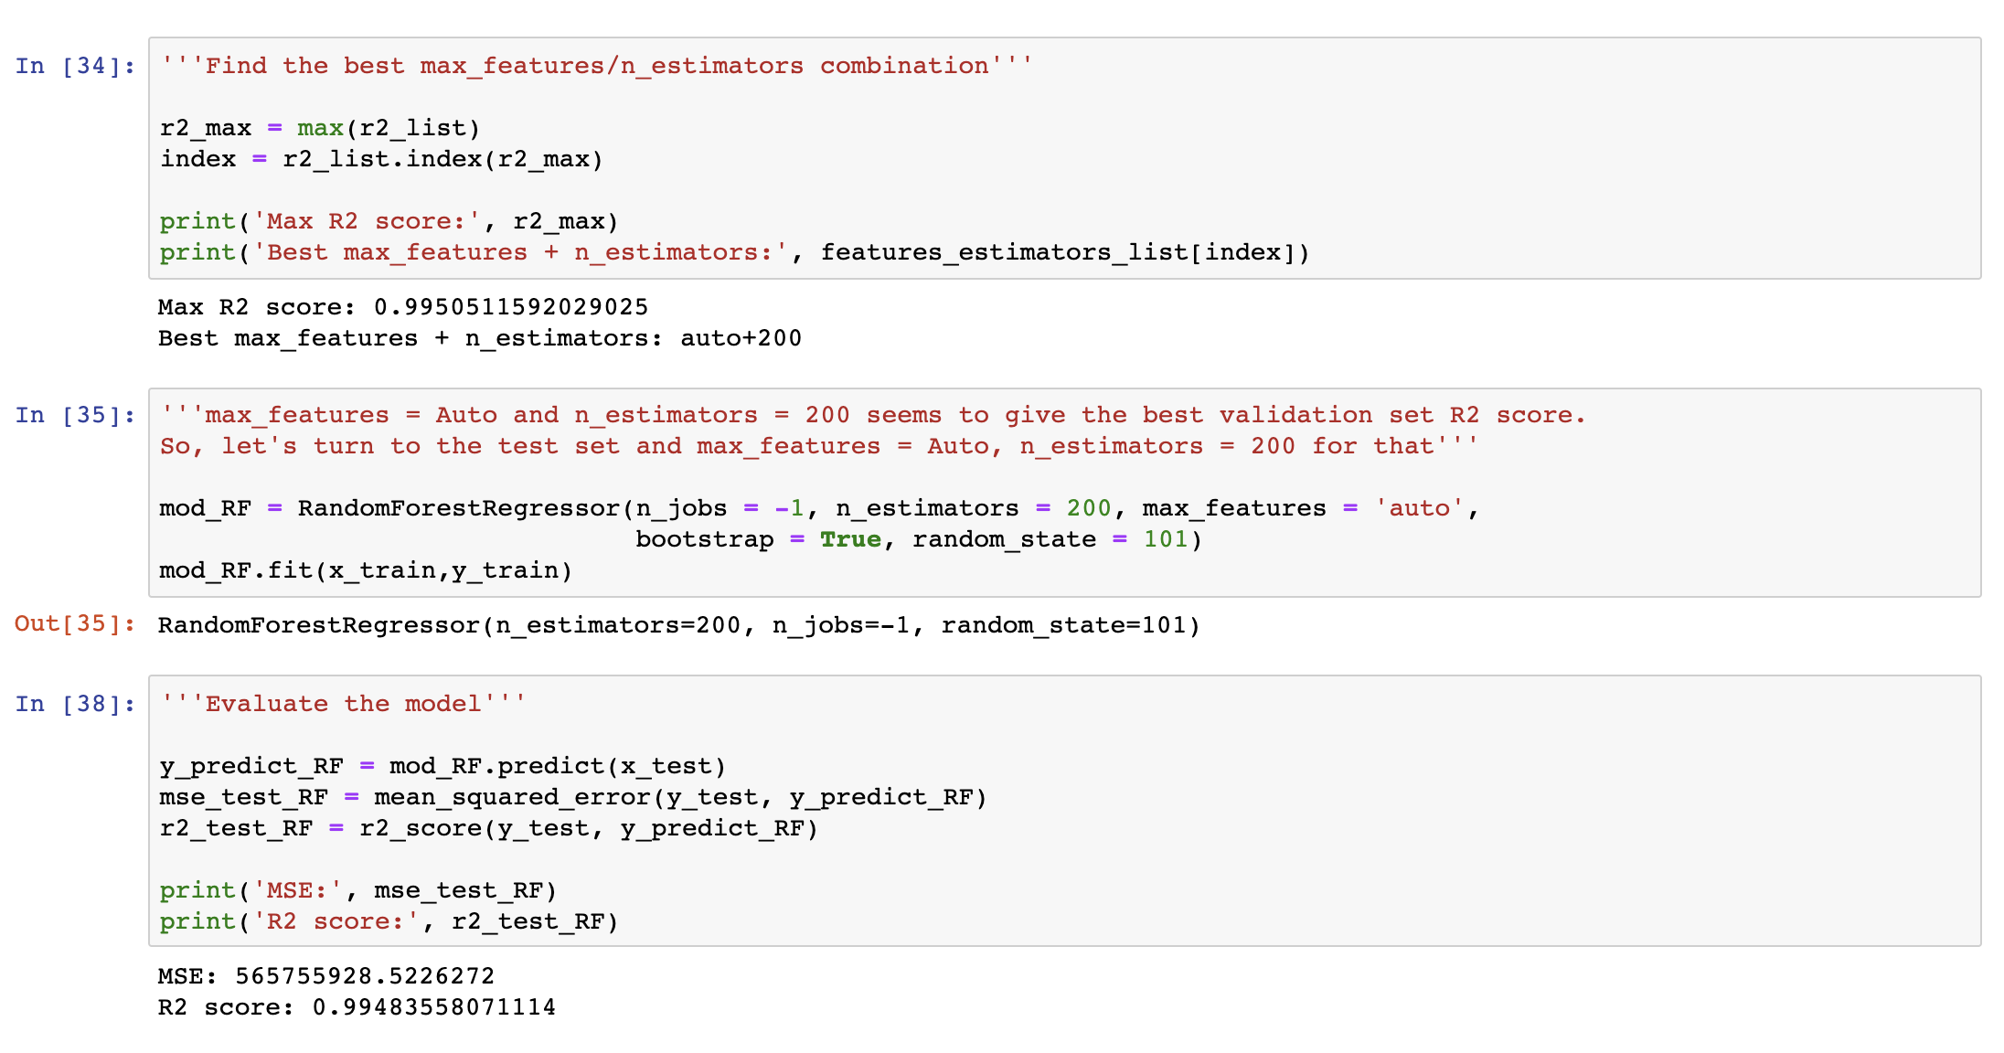
IV. Build Random Forests Models

Slide 15
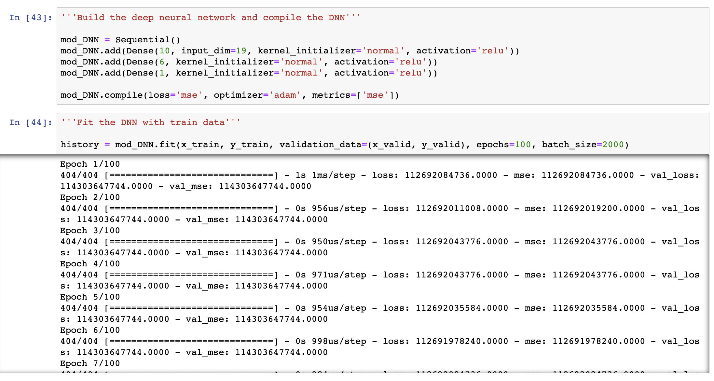
IV. Build Neural Networks Models
Build a deep neural networks for prediction with the updated datasets for prediction

Slide 16
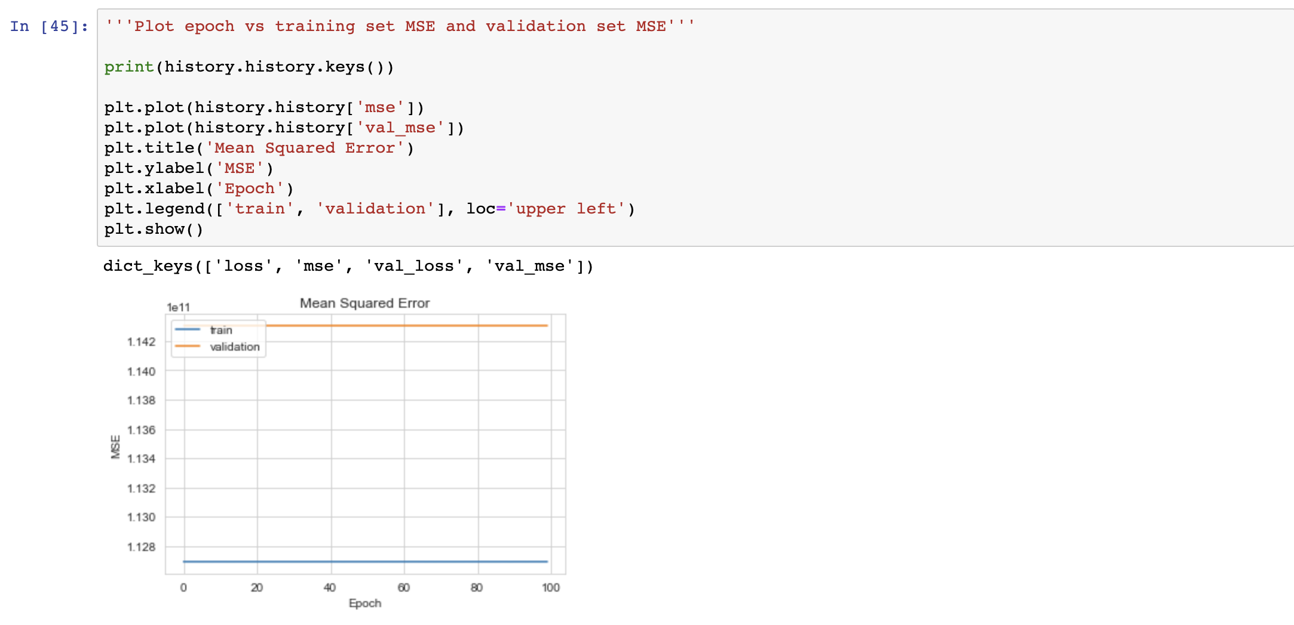
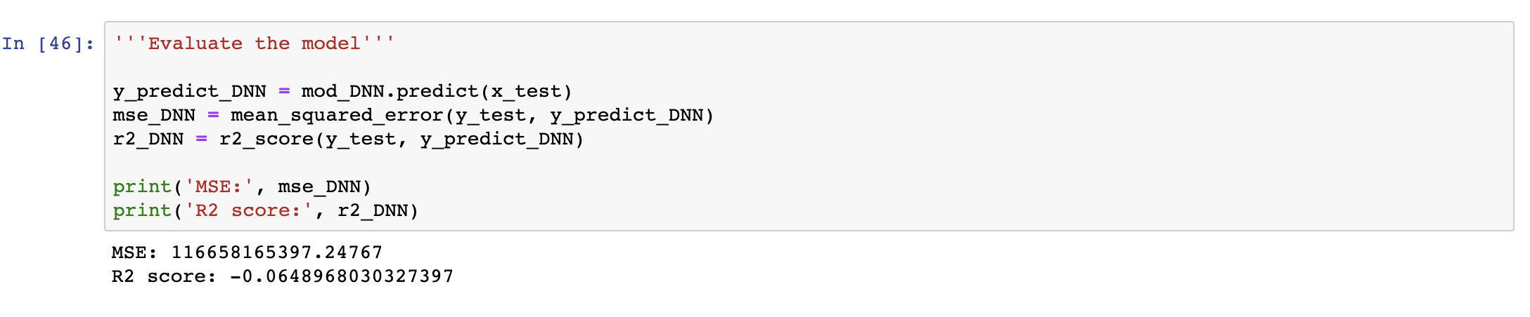

Slide 17
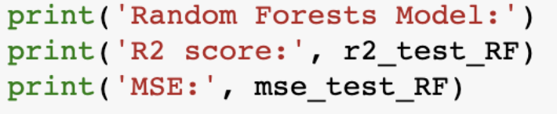
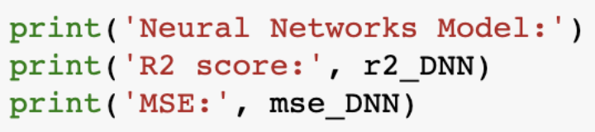
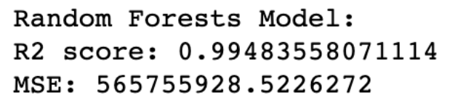
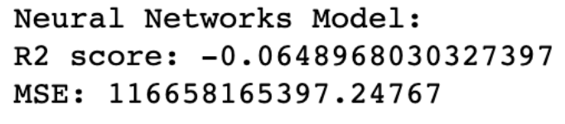
V. Evaluate Models on Test Data Sets
Random Forest Model
Neural Networks Model
We used the same rules that we used on train data set and validation data set on the test set and then used R-Squared & Mean Squared Error to evaluate our models

Slide 18
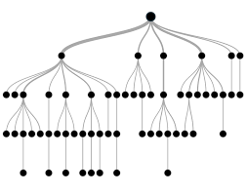

Results
Random Forests Model:
R2 score: 0.99483558071114
MSE: 565755928.5226272
Neural Networks Model:
R2 score: -0.0648968030327397
MSE: 116658165397.24767

Slide 19

Future Scopes
There are many ways that we can improve our models to make a prediction in the future.
For Random Forest Model, we can
Use more data or making our data into a more high-quality data with less missing values
Tune the hyperparameters of the algorithm
Use multiple algorithms
For Neural Networks Model, we can
Increase hidden layers
Trying to normalize and standardize our data more
Monitor or change the activation function in output layer

Slide 20

References
https://www.kaggle.com/edumucelli/spotifys-worldwide-daily-song-rank
https://www.kaggle.com/irisdorn/trends-in-spotify-s-worldwide-daily-songs-17-18
https://www.kaggle.com/key2success/top-streamed-songs-and-artists-on-spotify-of-2017
https://github.com/AishwaryaMurali1/DataScienceProject/blob/master/SpotifyWorldwideRanking.ipynb

Slide 21
Thank you!

